Slide 1



http://piracy.ssrc.org

Slide 2


Slide 3


Slide 4
http://piracy.ssrc.org
High prices, low incomes, and cheap digital technologies are the main ingredients of piracy.
Enforcement has been irrelevant to this relationship.

Slide 5
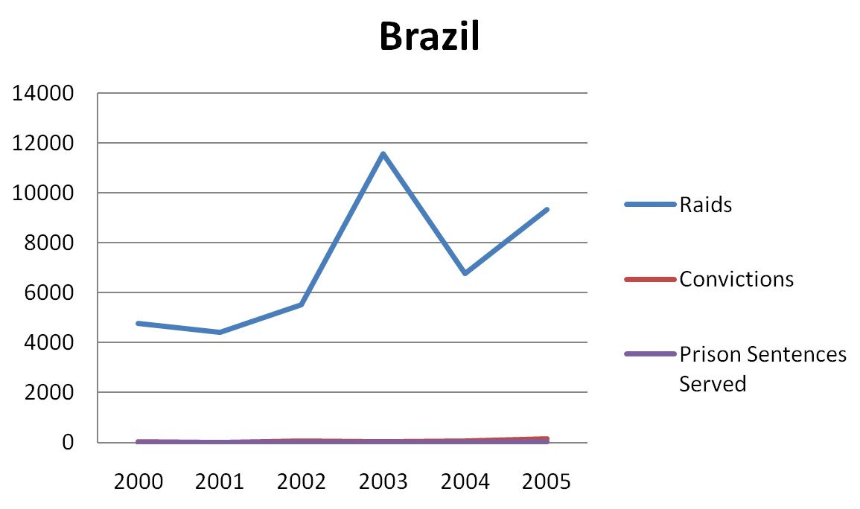
http://piracy.ssrc.org
Raids → Arrests → Convictions → Sentences Served / Fines Paid

Slide 6
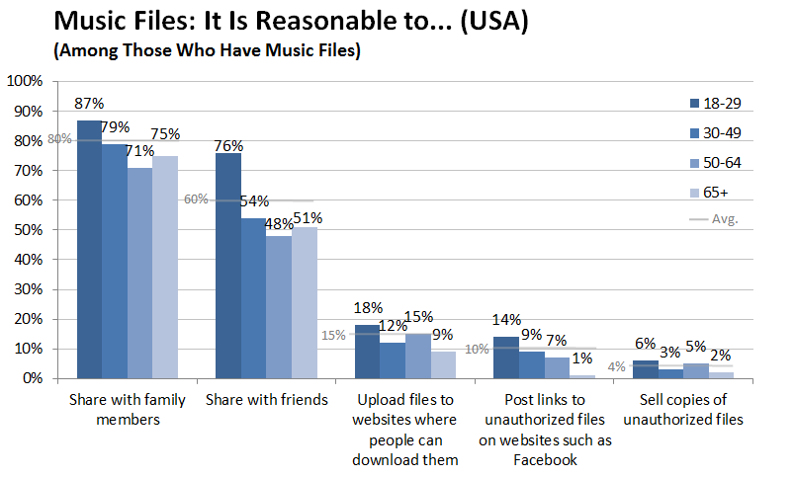
http://piracy.ssrc.org

Slide 7
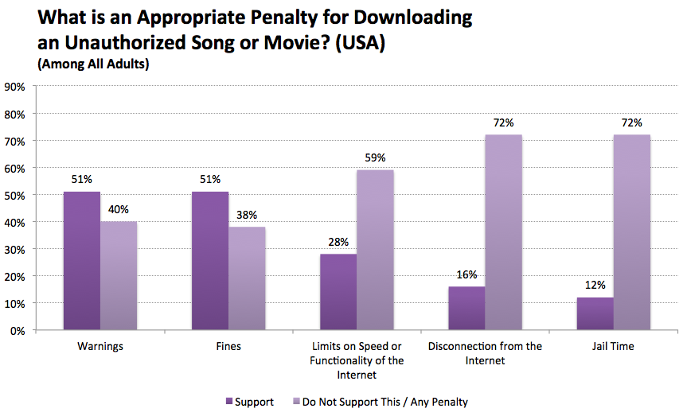
http://piracy.ssrc.org

Slide 8
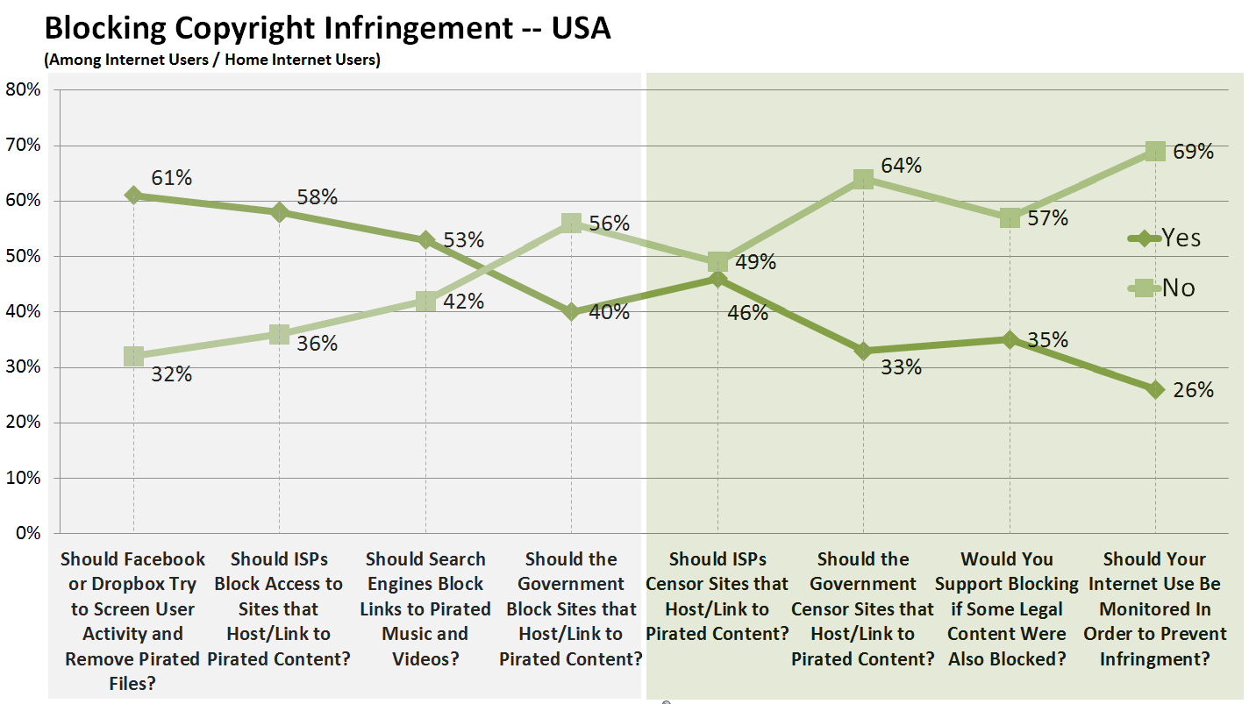

Slide 9
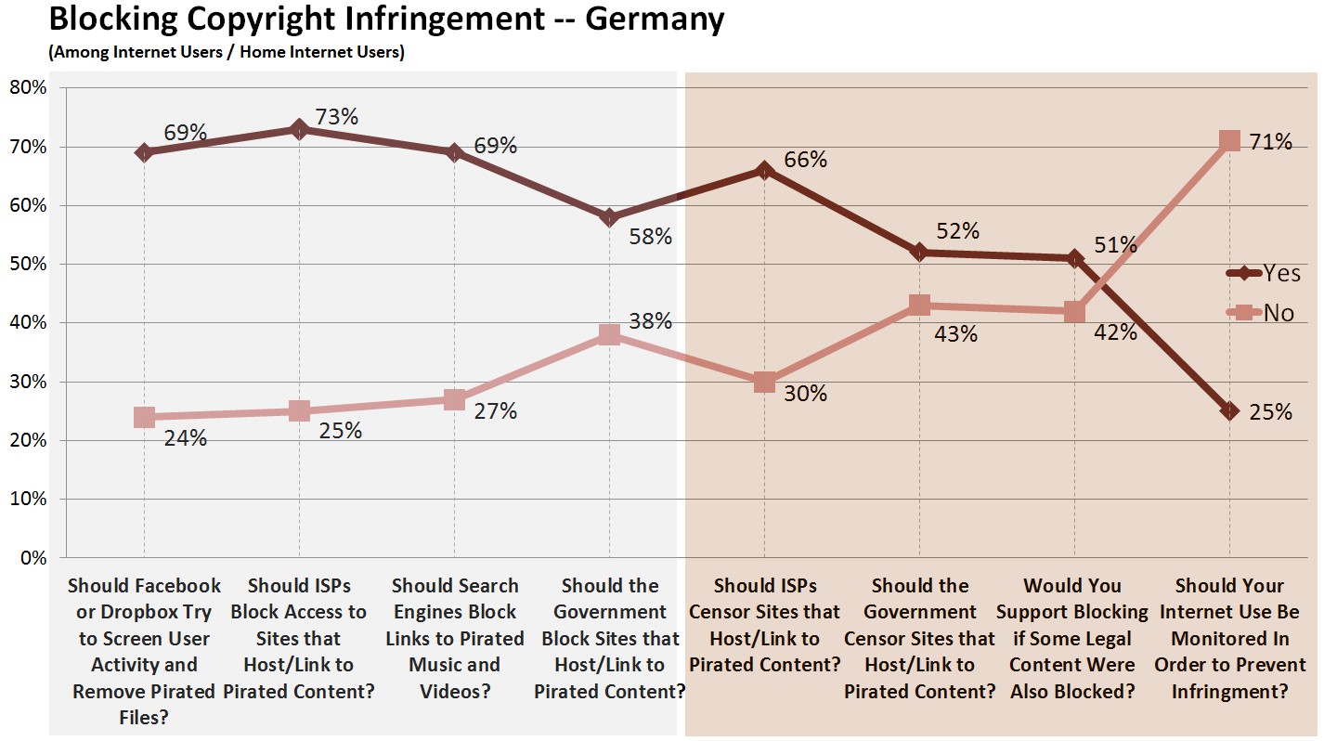

Slide 10
http://piracy.ssrc.org
The Ecology of Access to Educational Materials in Developing World Universities
Commercial Market
Library
Open Educational Resources
Digital Copying
Copy Shop

Slide 11
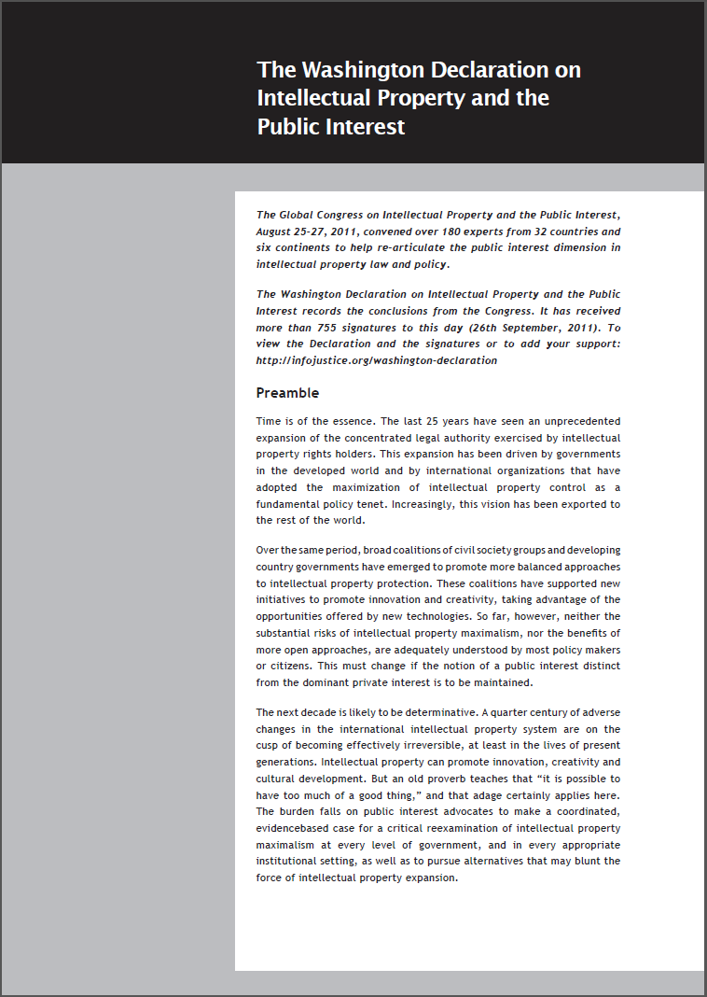
The Washington Declaration on Intellectual Property and the Public Interest
Ensure that policy making is based on research rather than faith or ideology.
Ensure that legal penalties and remedies are reasonable and proportional to the acts of infringement they target.
Defend the principle of domestic ‘exhaustion’ or ‘first sale’ in national law.
Introduce meaningful exemptions for research and educational uses into national laws.
http://infojustice.org/washington-declaration

Slide 12
http://piracy.ssrc.org
joe.karaganis@gmail.com

